Slide 1



Ambo University
Institute of Technology
Department of Computer Science
OES
Online Examination for
Ambo university

Slide 2
CHAPTER FIVE
System Design Using Object-Oriented Paradigm
Chapter Five

Slide 3
Outline
Overview of Phase I
Design modeling Class Diagram
Class Diagram
Deployment Diagram
Persistence Modeling
State chart
User interfaces
Testing

Slide 4
Review of phase one (I)
Chapter one: Introduction
Chapter two: current system.
Chapter three: proposed system.
Chapter four: system modeling using OO (object oriented) paradigm.
Review of phase Two(II)
Chapter 5: Object-oriented design.
Chapter 6: System implementation.

Slide 5
Class modeling
Is design level
introduces changes to analysis class model
It focuses on the solution domain

Slide 6
Design modeling Class Diagram
Three contents of Class:
The name of the class.
The attributes of the class.
The operation of the class.

Slide 7
CLASS DIAGRAM

Slide 8
Deployment Diagram
shows physical view of system
takes software into real world
shows how software gets assigned to hardware and how communicates.

Slide 10
Architecture of the system is client server.
Clients are responsible for:-
Receiving inputs from user
Checking range of performance
Server responsible for:-
Transaction performance
Guaranteeing the integrity of data.
Putting backup of database

Slide 11
Persistence Modeling
It describes the persistent data aspect of software system.

Slide 12
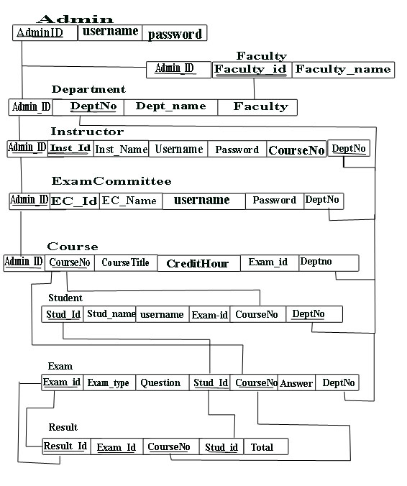

Slide 13
State chart
Is used to describe the behavior of an individual object
Transition is used as a progression from one state to another.
State chart Diagram of user login

Slide 14
State chart Diagram of user management on admin page

Slide 15
State chart Diagram of exam management on instructor page

Slide 16
State chart Diagram of exam management on Exam Committee page

Slide 17
State chart Diagram of exam page for student

Slide 18
State chart Diagram of result page for student and instructor

Slide 19
User interfaces
User interface design is the specification of the interaction between the system users and a system.
Navigation mechanism is part of user interface that takes the user form one part of the system to the other user system.
Input design is about designing a form and its controls for GUI system.
Output design is about designing reports like detailed, summarized,and etc.

Slide 20

Home Page of the System

Slide 21
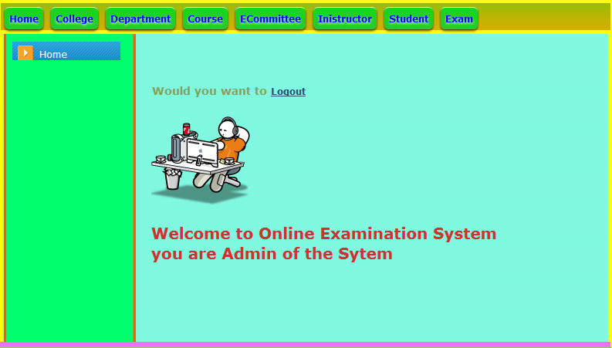
Home Page for admin of the System

Slide 22
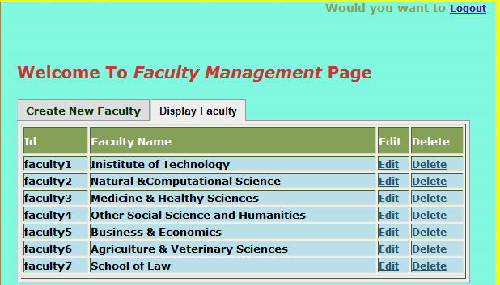
Faculty Management Page of the System

Slide 23
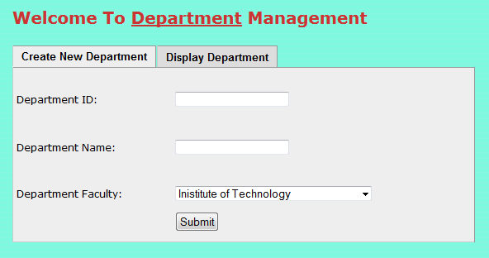

Slide 24
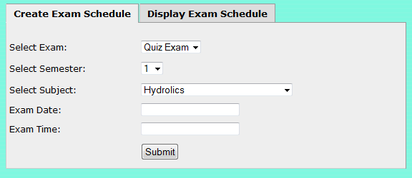
Schedule adding page of the system

Slide 25
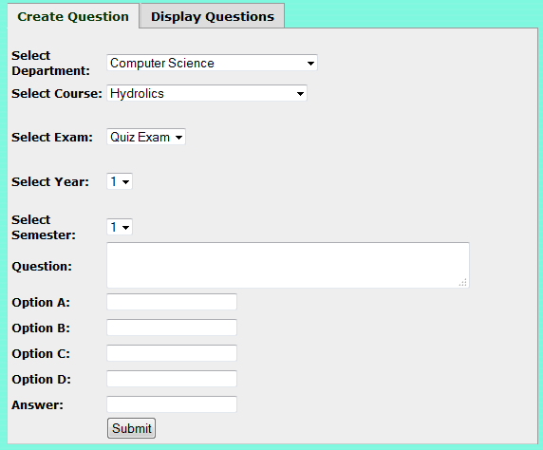
Exam adding page of the system

Slide 26
Chapter Six
System Implementation and Testing

Slide 27
System Conversion
Parallel Conversion
Channel Conversion
Straight Conversion
Unit testing
System testing
Volume testing
Testing Techniques Methodologies

Slide 28
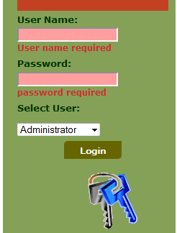
Testing User Interface

Slide 29
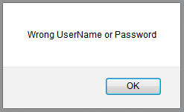

Slide 30
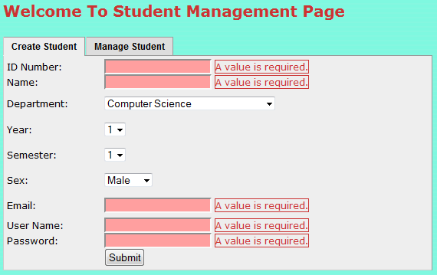
Admin page to add user to the system (missing Values) testing:

Slide 31
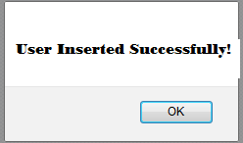
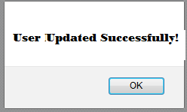
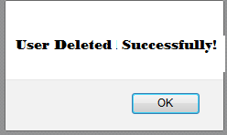
Admin page to add user to the system (correct value) testing:

Slide 32
THANK YOU!

